Slide 1
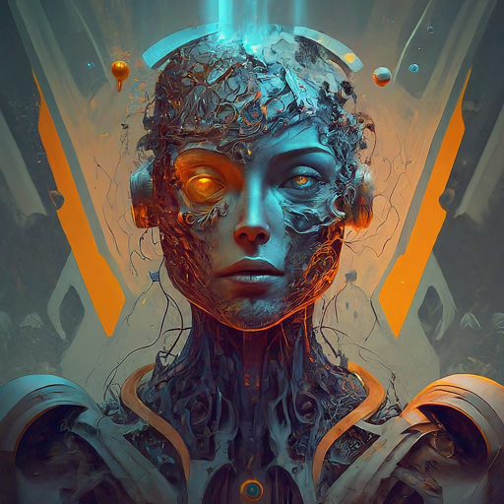
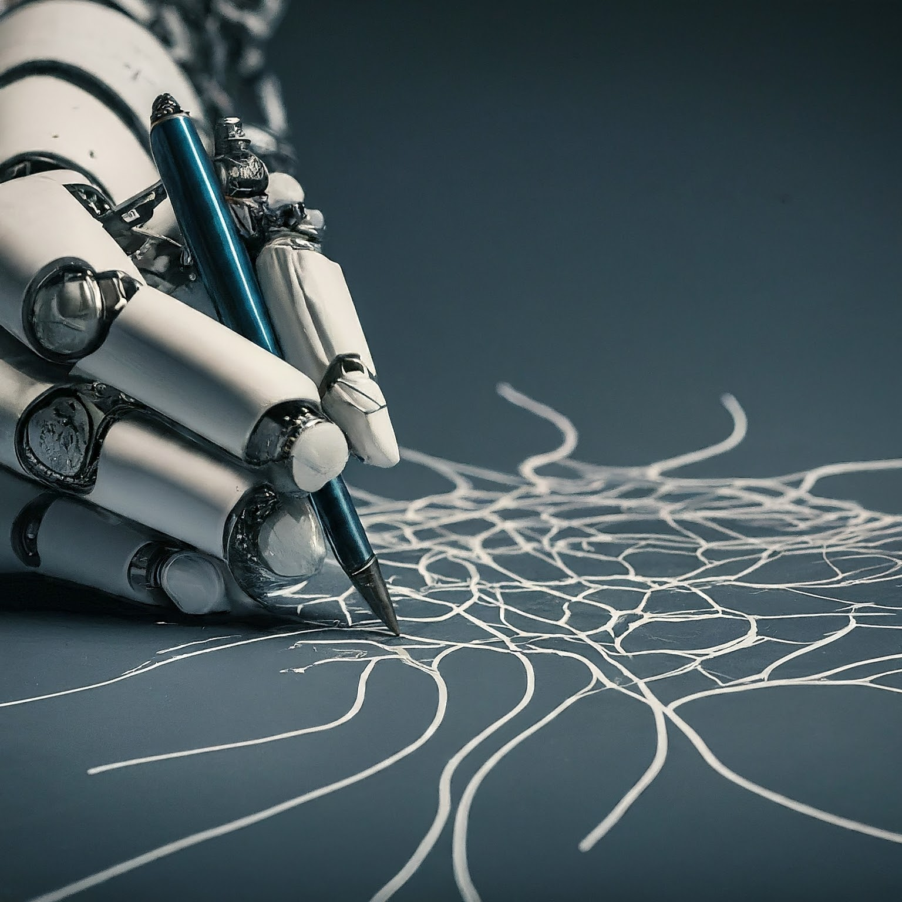
AI and Beyond : Machine Learning and Generative AI

Slide 2
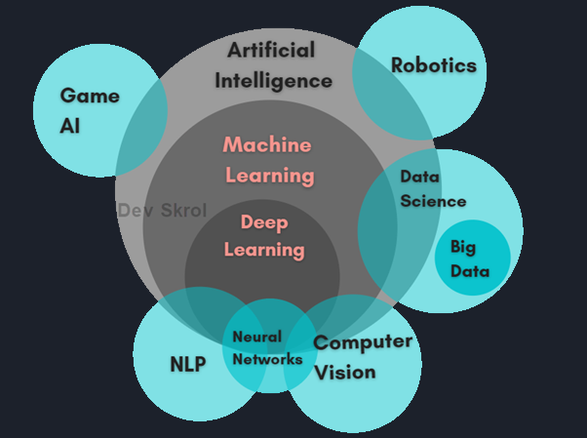
What is AI?
AI is technology that mimics human intelligence to perform tasks.
AI can be broken down into several subfields, including:
Machine Learning
Natural Language Processing(NLP)
Computer vision
Robotics
Deep Learning

Slide 3
Why do we need AI?
The goal of AI is to create machines that can think and act like humans, or even surpass human intelligence in certain areas.
Optimize human effort
Speed and efficiency
Accuracy and precision
Handle complex data
We humans want commercial profits
AI can be tricked by "adversarial attacks," where minor changes to input data can cause it to make completely wrong predictions.

Slide 4
Facts About AI
AI in Wildlife Conservation
AI is being used to combat illegal wildlife trade. By analyzing online marketplaces and social media, AI can identify and track illegal sales of endangered species, helping authorities take action.
AI in Archaeology
AI is revolutionizing archaeology by analyzing satellite images to discover ancient sites. For example, AI has helped identify thousands of potential archaeological sites in the Middle East that were previously unknown.
AI in Music Composition
AI can compose original music. OpenAI’s MuseNet can generate music in various styles, from classical to pop, and even blend different genres to create unique compositions.

Slide 5
AI in Art
AI-generated art has gained significant attention. In 2022, AI-generated artworks fetched over $1 billion in sales, showcasing the growing acceptance and value of AI in the art world.
AI in Agriculture
AI-driven precision farming techniques can increase agricultural productivity by up to 70% by optimizing planting, watering, and harvesting processes. This technology is crucial for meeting the food demands of a growing global population.
AI in Predictive Maintenance
In industries like manufacturing and aviation, AI is used for predictive maintenance. By analyzing data from machinery, AI can predict when equipment is likely to fail, allowing for timely maintenance and reducing downtime.

Slide 6
Types of AI
Narrow AI: AI that is designed to perform a narrow task (e.g., facial recognition).
General AI: AI that has the ability to perform any intellectual task that a human can do (Sophia).
Super AI: AI that surpasses human intelligence(In science fiction, characters like HAL 9000, an AI from the movie '2001: A Space Odyssey,' are often depicted as Super AI)

Slide 7





Key Concepts in AI and Machine Learning
Training a ML model with labelled dataset
Supervised learning
Unsupervised learning
Reinforcement learning
Deep learning
Neural networks
Training a ML model with unlabelled data
Ex: Clustering or grouping of data based on similarities between the data
Ex: Image Classification of Orange and Mango
Orange: Mango:
Colour- orange Colour- Yellow
Shape- Oval shaped Shape- Oblong shape
Texture- Bumpy texture Texture- Smooth
Types of Machine Learning
Training a ML model based on reward and penalty method
We reward the model for correct prediction and punish it for a wrong prediction
Ex: Training a Dog to do tricks

Slide 8
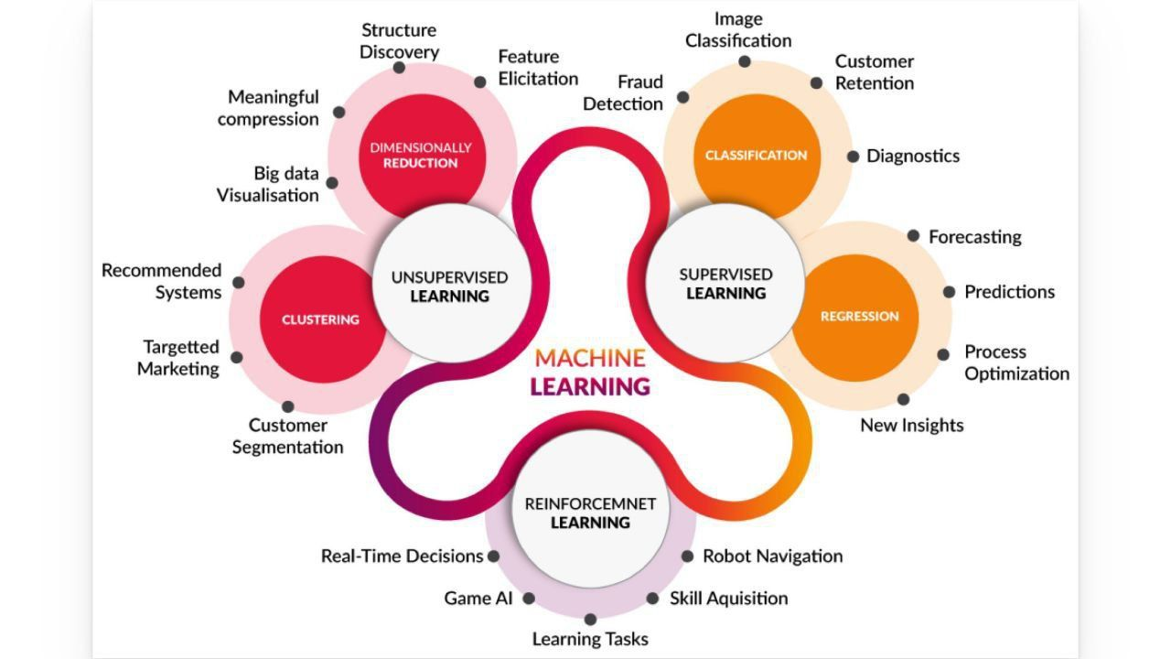

Slide 9
Steps involved in developing a machine learning model
Data collection & Data Preparation
  Numpy, Pandas, etc
Data Analysis and feature engineering
  Pandas, scikit-learn, seaborn (data visualization)
Train algorithm on training and validation data
  Keras, Pytorch, scikit-learn
Test the algorithm on test data
  scikit-learn
Deploy the algorithm
  Docker, Streamlit

Slide 10

Will AI Replace Programmers?

Slide 11
Will AI Replace Programmers?
Technical the answer is No, at least not for this decade or so but….🤞
Software projects involve more than just programming,
Say, In case of Full stack development, it involves:
Architecture of Project
Framework
Database Design
UI / UX Design
AI can't handle everything independently, it can assist in developing certain components of a project and speed up the development, but it cannot create the entire project on its own

Slide 12
Current Impact of AI on Programming
AI is already transforming the field of programming in several ways:
Automation of Repetitive Tasks: AI tools can handle mundane tasks like code formatting, bug detection, and even some aspects of code generation.
Enhanced Productivity: AI-powered assistants like GitHub Copilot and OpenAI Codex help programmers write code faster and with fewer errors.
Limitations of AI in Programming
Despite these advancements, AI has significant limitations:
Complex Problem-Solving: AI struggles with complex, creative problem-solving that requires deep understanding and critical thinking.
Human Oversight: AI-generated code often needs human review to ensure it meets project requirements and is free of subtle bugs.

Slide 13
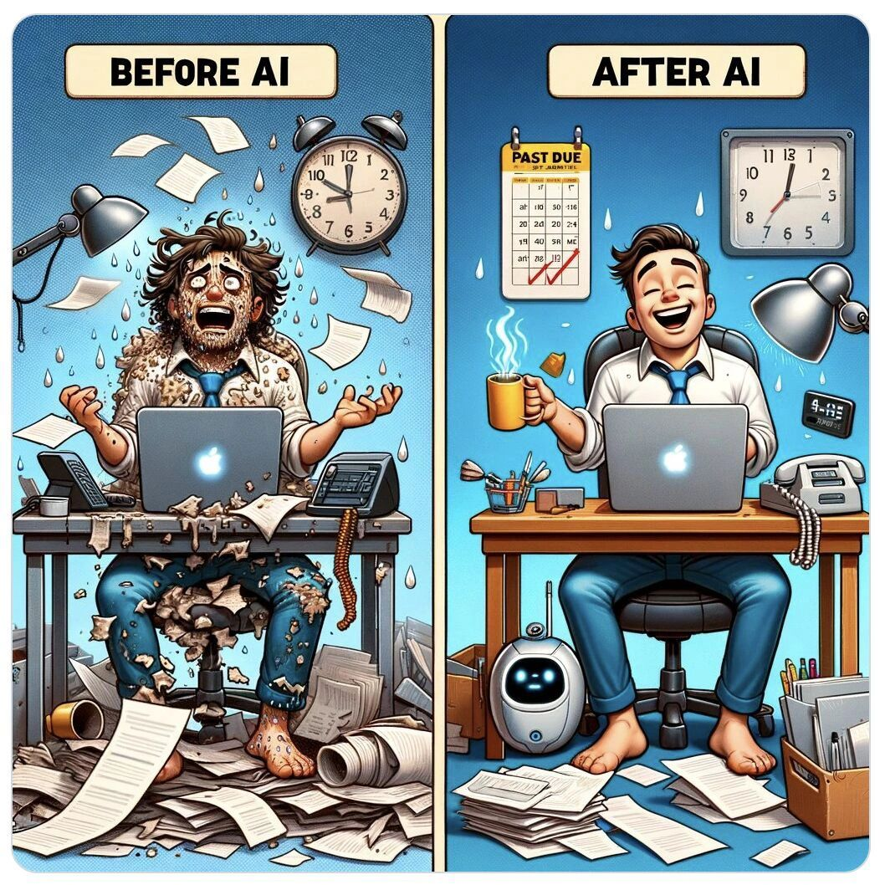
Future Outlook
While AI will continue to evolve and take over more routine tasks, it is unlikely to completely replace programmers in the near future. Instead, the role of programmers will shift:
Collaboration with AI: Programmers will increasingly work alongside AI tools, leveraging them to enhance their productivity and creativity.
Focus on Higher-Level Tasks: Human programmers will focus more on strategic, high-level tasks that require human intuition and innovation

Slide 14






Current Industry Trends
AI & ML Industry
Python, Databricks, Apache Spark, ML pipelines,Snowflake
Data Science Industry
To Train these large models you need a lots of data
Tools—> Powerbi, Excel, Tableau, MatplotLib, Pandas
Cloud Computing Industry
These models also need lots and lots of cloud resource
Tools—> Docker, Kubernetes, Github Actions, GCP, Azure, AWS

Slide 15
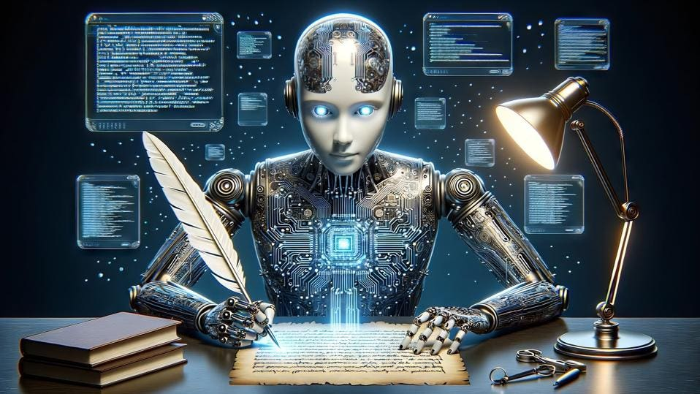
Gen AI(Generative AI)
Generative AI: An Introduction
•Generative AI refers to a category of artificial intelligence (AI) algorithms that generate new outputs based on the data they have been trained on. Unlike traditional AI systems that are designed to recognize patterns and make predictions, generative AI creates new content in the form of images, text, audio, and more.
•Generative AI uses a type of deep learning called generative adversarial networks (GANs) to create new content. A GAN consists of two neural networks: a generator that creates new data and a discriminator that evaluates the data. The generator and discriminator work together, with the generator improving its outputs based on the feedback it receives from the discriminator until it generates content that is indistinguishable from real data.

Slide 16
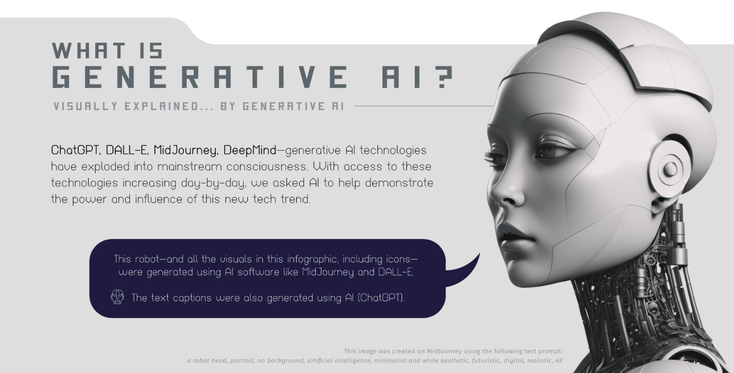

Slide 17
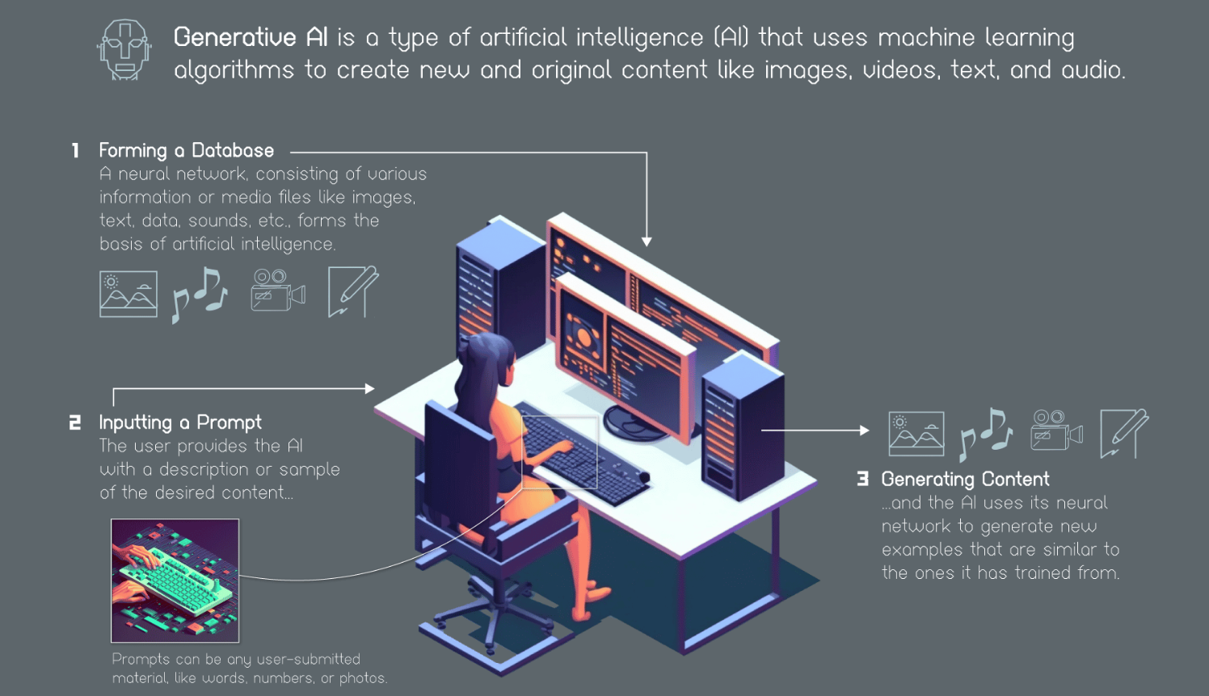

Slide 18
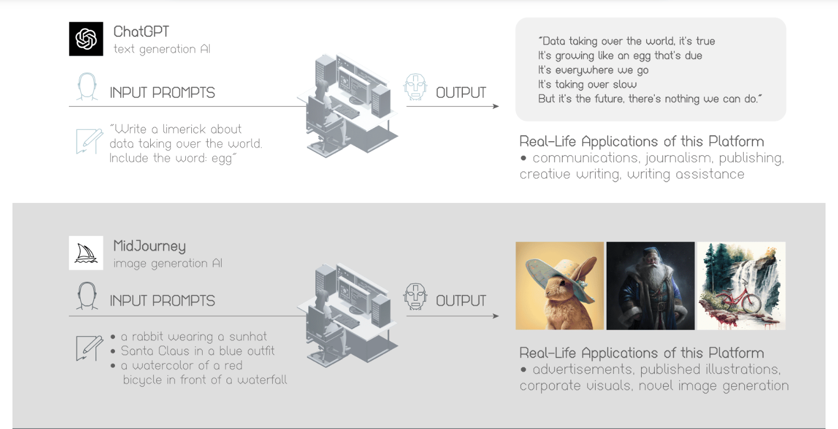

Slide 19
Journey of 4 Years
1st Year-
  Enjoy your college life
  Maintain your CGPA
  Join our College clubs, for eg: GSDC (Google Student Developer Club), CodeChef, Gaming Club, etc.
  Practice programming in websites like GFG (GeeksforGeeks), LeetCode, CodingNinjas
  Connect with people in Linkedin
2nd Year-
  Explore different fields like web development, AI & ML & etc
  Start building your Resume by doing projects(try new projects)
  Attend Hackathons, Competitions, Events
  Get Good Certifications which really update you

Slide 20
Journey of 4 Years
3rd Year-
  Start your Placement Preparation
  Start preparing DSA from websites like TUF (TakeUForward), Leetcode
  Start practicing General Aptitude questions from websites like India Bix, Prep Insta
4th Year-
  Campus Placements(Aptitude, Coding rounds, Technical Interviews, HR Interview)
  Major & Minor Projects
  Practice mock interviews

Slide 21
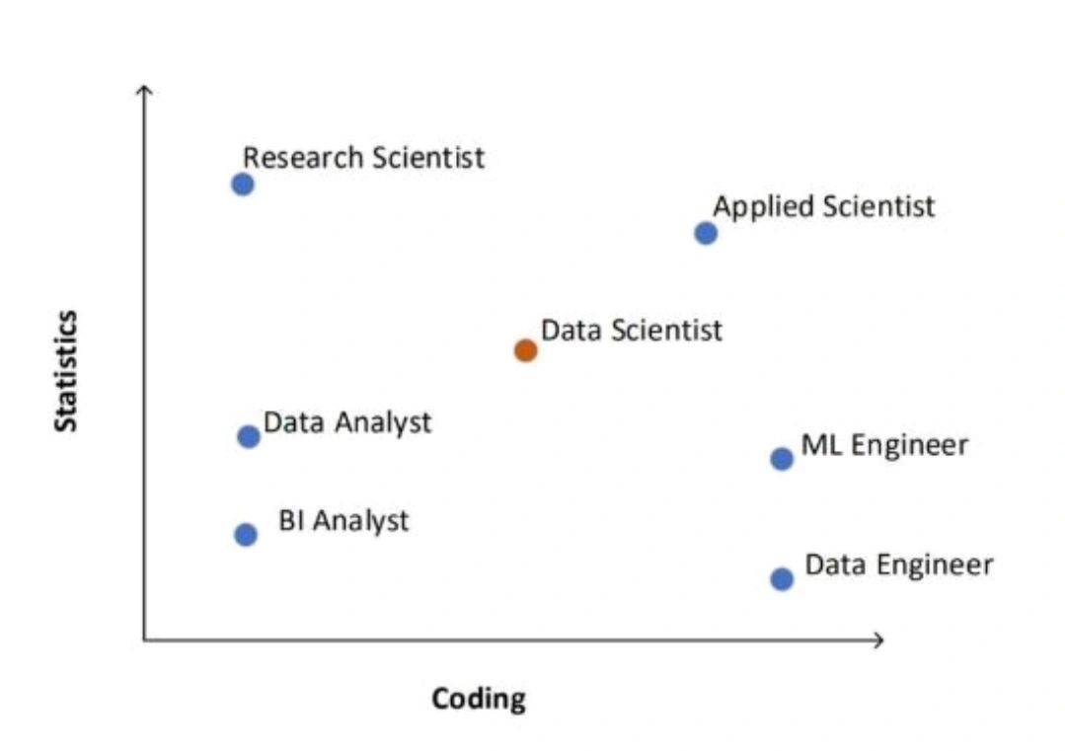

Slide 22
General Tips for your 4 year Journey
Maintain your cgpa > 9 or 9.5 (shows your strength in the core subjects)
Full Proficiency in at least one programming language
Explore about frameworks (MERN, MEAN,Django, Springboot,.Net)
Learn Linux
Learn to use Github, Docker
Learn any one cloud basic (GCP, Azure, AWS)
Practice DSA (+++ for placements)
Build Connections

Slide 23
Become a High Paid Software Engineer, Only Resources you need👇
•Learn Programming Language : W3schools
•Learn OOPs : JavaTPoint / GeeksForGeeks
-Practice Coding : Hackerrank
•Learn Operating System, DBMS, ComputerNetworks : Knowledge Gate (YT)
•Learn DSA : Striver's A2Z DSA (YT)
-Practice DSA : Leetcode, CodeForces, CodeChef, GFG

Slide 24
•Learn SQL : W3Schools / GeeksForGeeks
-Practice SQL : W3Schools / GeeksForGeeks
•Learn Web Dev : Net Ninja (YT)
-Practice Web Dev : Visual Studio Code
•Learn Machine Learning/Deep Learning : Coursera Andrew Ng Course
-Practice Machine Learning : Google Collab

Slide 25


Slide 26

Connect with me through LinkedIn

